Slide 1
Programming with Java/Python
Anan Yaagoub - PhD
Northwestern University

Slide 2
Week 2 - Agenda
Functional programming
  Recursion, comprehension, generators, functions, and higher-order functions.
Python Code Structure
  Module, Package, Objects, and Variable scope
Algorithms and Big-O
  Search and Sort
Extensions
  NumPy, matplotlib, Turtle, PIL, ..

Slide 3
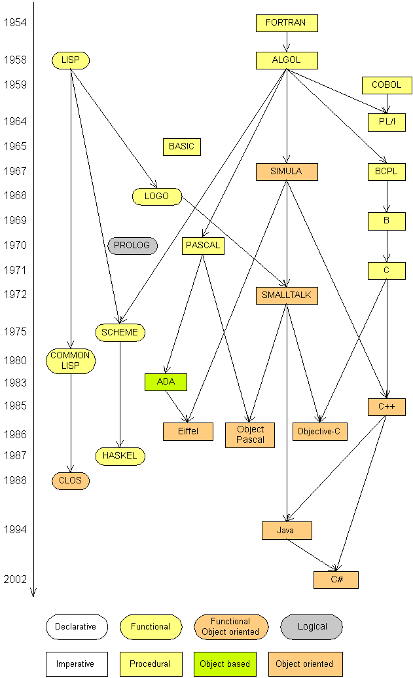
Programming Languages
Some influential ones:
  FORTRAN
    science / engineering
  COBOL
    business data
  LISP
    logic and AI
  BASIC
    a simple language

Slide 4
Programming Languages Paradigm
Programming languages support decomposing problems in several different ways:
  Procedural/imperative: allows side effects.
  Declarative: specification that describes the problem.
  Object-oriented: collections of objects that have internal state and support methods .
  Functional programming decomposes a problem into a set of functions. Ideally, functions only take inputs and produce outputs, and don’t have any internal state that affects the output produced for a given input. (pure functional-disallows side effects)
Python is multi-paradigm language: it supports imperative, OO and functional programming paradigms.

Slide 5
Functional Programming
What is (pure) functional programming?
  Solution is a collection of functions
  Function call other functions
  Function can be passed as parameters
  Function Chaining.
  Language support High-order functions and objects
Advantageous properties of functional programs:
  Code is clearer and more compact.
  Parallelization means running the same code concurrently without synchronization. (on multiple processors).
  Lazy evaluation is a compiler technique that avoids running code until the result is needed. (i.e. Generators)
  A process is deterministic if repetitions yield the same result every time. (Less bugs)
  Ease of debugging and testing
  Performance (C vs core Python)

Slide 6

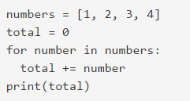

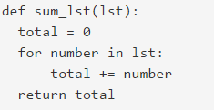
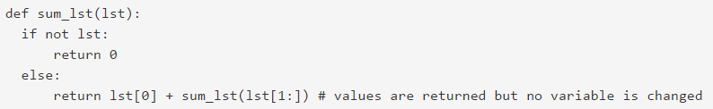
Basic concepts of functional programming
expressions vs statements: The first one means that the code should tell what it aims to do instead of how to do it
the lack of data mutation: once a variable assumes a value it will never change on the course of the program execution

Slide 7
Python features that makes a foundation for writing functional-style programs
Iterators:Data Types That Support Iterators
  An iterator is an object representing a stream of data; this object returns the data one element at a time.
  The built-in iter() function takes an arbitrary object and tries to return an iterator that will return the object’s contents or elements, raising TypeError if the object doesn’t support iteration.
  Several of Python’s built-in data types support iteration, the most common being lists and dictionaries.
  An object is called iterable if you can get an iterator for it.
Generator expressions and list comprehensions
  declarative way of using loops to iterate over collections
  epression for exp in iterable if condition
  perform some operation for every element
  select a subset of elements that meet some condition
Generators – functions
  return an iterator that returns a stream of values.

Slide 8
Python features Cont …
Functions are first class objects
Higher-Order built-in functions
  map(), filter(), zip(), sorted(), sum(), reduce() …
Lambda – anonymous function
  used when passing a simple function as an argument to another function
The operator module
  set of functions corresponding to Python’s operators. These functions are often useful in functional-style code because they save you from writing trivial functions that perform a single operation.
The functools module
  Set of functions that takes one or more functions as input and returns a new function.
  Example: functools.partial() function.
The itertools module
Recursion

Slide 9
Functions are first class objects
Can be assigned to a variable
Can be passed as a parameter
Can be returned from a function
Functions are treated like any other variable in Python, the def statement simply assigns a function to a variable
Parameters: positional, default values, named, and dynamic number
…

Slide 10
Recursion
Recursion is a method of solving problems that involves breaking a problem down into smaller problems until you get to a small enough problem that it can be solved trivially.
Usually recursion involves a function calling itself.
The Three Laws of Recursion
  A recursive algorithm must have a base case.
  A recursive algorithm must change its state and move toward the base case.
  A recursive algorithm must call itself, recursively.
Max level of recursion?

Slide 11
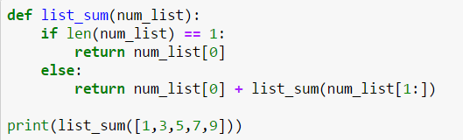
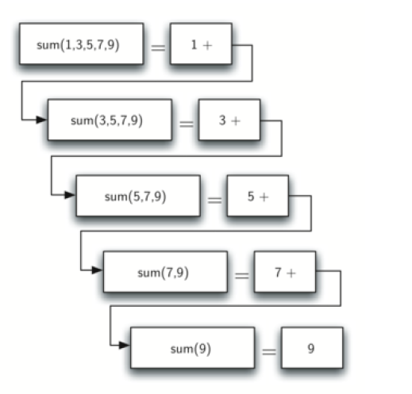
Recursion – List Sum

Slide 12
Infinite Recursion
If a recursion never reaches a base case, it goes on making recursive calls forever, and the program never terminates.
Example:
  def recurse():
    recurse()
In most programming environments, a program with infinite recursion does not really run forever. \
Python reports an error message when the maximum recursion depth is reached.
>>> factorial(1.5)
RuntimeError: Maximum recursion depth exceeded

Slide 13
Modules & Packages
Any Python file is a module, its name being the file's base name without the .py extension.
A package is a collection of Python modules: package is a directory of Python modules containing an additional __init__.py file, to distinguish a package from a directory that just happens to contain a bunch of Python scripts.
Packages can be nested to any depth, provided that the corresponding directories contain their own __init__.py file.

Slide 14
Modules: Imports
import mymodule | Brings all elements of mymodule in, but must refer to as mymodule.<elem>
from mymodule import func1 | Imports func1 from mymodule right into this namespace
from mymodule import * | Imports all elements of mymodule into this namespace
import matplotlib as mp | Use Alias

Slide 15
Modules import …
if __name__ == "__main__":
  ….
Ambiguous naming
Use dir() and dir(module)
import Library Module Search Path:
  When a module named spam is imported, the interpreter first searches for a built-in module with that name.
  If not found, it then searches for a file named.py in a list of directories given by the variable sys.path
sys.path is initialized from these locations:
  The directory containing the input script.
  PYTHONPATH - shell variable (a list of directory names)
  The installation-dependent default -- C:\Anaconda3\Lib
sys.path modification
  import sys
  sys.path.append('C:\MSiA\myPyProjects\PackagesAndModules')

Slide 16
OOP
OOP is one of the most powerful tools of Python, but nevertheless you don't have to use it
major principles of object orientation are:
  Encapsulation
  Data Abstraction
  Polymorphism
  Inheritance
An object oriented program is based on classes and there exists a collection of interacting objects, as opposed to the conventional model, in which a program consists of functions and routines.
In OOP, each object can receive messages, process data, and send messages to other objects.

Slide 17
Objects / Classes
An object is a data structure, together with a set of procedures that operate on the data. Basic procedures can be written in an imperative or a functional style.
Object-oriented programming Used as:
  Real problem Modeling
  Data structure
  Data Type
  Libraries - reusability
Class: is object blueprint (how is the object created and how it works)
Examples: python built-in data types

Slide 18
Algorithms: Search and Sort
Search
  Sequential
  Binary
  Hash
Sort
  selection
  bubble
  merge
  quick
  insertion
  Shell
  Timsort
how these algorithms work?
how they compare to one another? Big O()

Slide 19
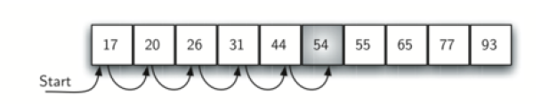

Search: Sequential

Slide 20
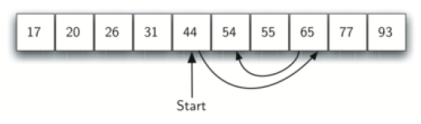
Search - Binary
Ordered Collections
Divide and conquer
  divide the problem into smaller pieces
  solve the smaller pieces
  reassemble the whole problem to get the result.
Procedural and recursion
The number of comparisons: 𝑖
Solve (𝑛 / 2**𝑖 = 1)
𝑖 = log 𝑛.
𝑂(log 𝑛)

Slide 21
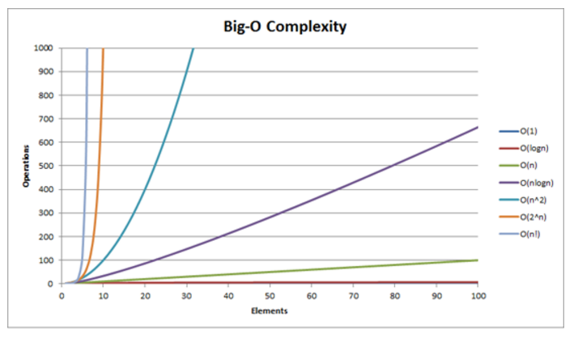
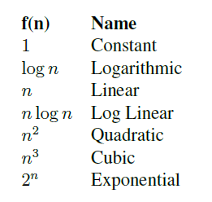
Big O - comparisons
Programmatic Measures:
  Time (use timers)
  Space (in bytes)
  Number of comparisons
  Number of swaps

Slide 22
Search - Hashing
Data structure searched in 𝑂(1)
Future lectures

Slide 23
Sort in Python
Sorted() – built-in function returns new list
List sort() method – sort same list
Python uses Timsort algorithm
Example 1:
  sorted([5, 2, 3, 1, 4])
  [1, 2, 3, 4, 5]
Example 2:
  a = [5, 2, 3, 1, 4]
  a.sort()

Slide 24
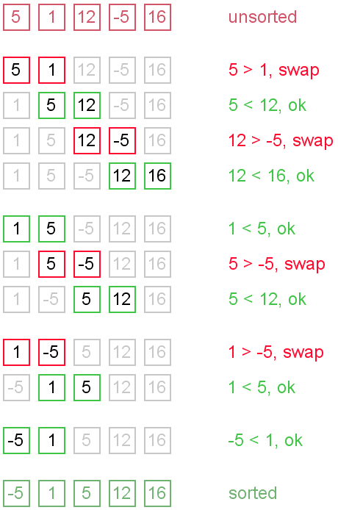
Bubble Sort
A Bubble Sort is a sorting algorithm that compares two adjacent data at a time and swaps them if they are in the incorrect order.
It runs through the list of data to be sorted until there are no more swaps that need to be done.
It is a very slow yet simple algorithm.

Slide 25
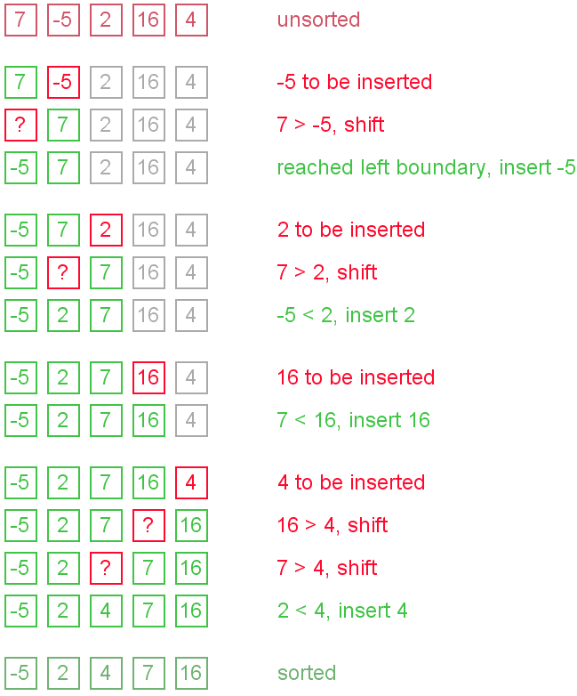
Insertion Sort
Insertion sort is a sorting algorithm runs through each element of a list, consuming one element upon each repetition, and growing a sorted sub list.
Upon each iteration, insertion sort removes one element from the input data, finds the location it belongs within the sorted list, and inserts it there.
It repeats until no input elements remain.

Slide 26
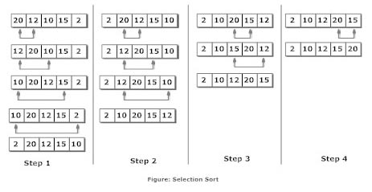
Selection Sort
Selection Sort is a sorting algorithm that sorts a list from left to right by taking the unsorted value and swapping it with the leftmost unsorted value upon each iteration.
Once the value is swapped with the leftmost unsorted values, it is then considered a sorted value
After the algorithm has done this for every value in the list, then the entire list will have been sorted.

Slide 27
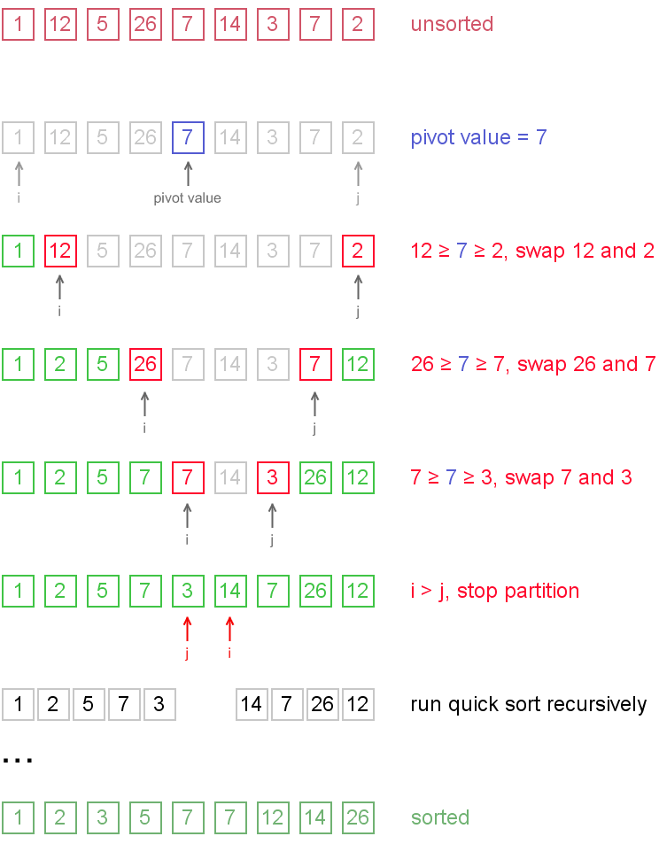
Quick Sort
Quick Sort is a sorting algorithm that works by selecting a pivot from a list, and then reordering the list so that all of the elements that are smaller than the pivot go to the left, and all of the elements that are larger than the elements go to the right.
Quick sort then recursively applies this algorithm to each of the smaller/larger sub lists until the pivots have reached their correct sorted position in the list.

Slide 28
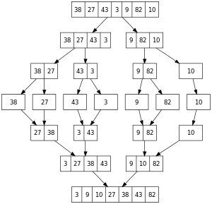
Merge Sort
A Merge Sort is a sorting algorithm that works by dividing an unsorted list into sublists that all contain 1 element
Repeatedly merging these sublists until there is only 1 sorted list remaining.
Merging sorted sublists (single element sublists are always sorted) is very efficient because it only requires one comparison between the current elements of either sublist to add an element to the merged list.

Slide 29
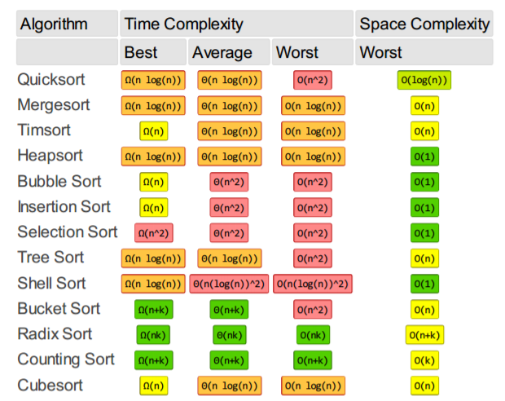
Collections Sort Algorithms
Visualization:
http://wonderfl.net/c/4xiQ/fullscreen
http://sorting.at/#
cheat-sheet:
http://bigocheatsheet.com/pdf/big-o-cheatsheet.pdf

